Slide 1
War Stories
Why incentives don’t always align, big organizations don’t work the way you think they will, and people don’t behave the way they’re “supposed to”

Slide 2
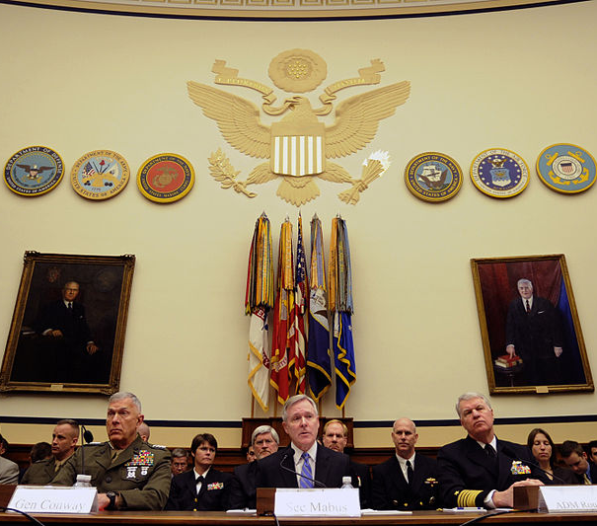
Background: Navy Energy Strategy
Goals:
1.) Energy Efficient Acquisition
2.) Sail the “Great Green Fleet” by 2016
3.) Reduce Non-Tactical Petroleum Use by 50% by 2015
4.) Increase Alternative Energy Use Ashore to 50% of Total by 2020
5.) Provide 50% of Total DoN Energy with Alternative Energy by 2020
“The requirement for having a global presence using innovative, low-cost, light-footprint engagements, while continuing to protect the global commons, means decreasing our reliance on fossil fuels must be at the top of our agenda.”
- Secretary of the Navy Ray Mabus, Foreign Affairs, 2013

Slide 3
Cost Recovery? Who Cares?
Cost Recovery Analysis of DoN Energy Projects (figures in $M)
“There was a prevailing belief among Navy and Marine Corps officials that Recovery Act FSRM and MILCON energy projects did not have to be cost-effective.”
-DoD Office of the Inspector General, Report D-2011-106, 9/22/2011

Slide 4
Great Balls of Fire: Air ENCON
F/A-18 Super Hornet
Length: 60 ft, 3 inches
Max Takeoff Weight: 66k lbs
Internal Fuel: 18,840 lbs
Normal Fuel Use: ~ 70 lbs / min
Combat Fuel Use: ~ 600 lbs / min (altitude depending)
Number in Service: 801
GOAL: Cut operational fuel use by 4% by 2020
ISSUES: Whose budget? What are the incentives? How are squadrons measured? How can commanders game the system?

Slide 5
Takeaways
The Navy is a BIG mission-driven organization, with a lot of moving parts
The incentives at work aren’t always what you think they are
Incentives that don’t align don’t change behavior the way you think they will

