Slide 1
Policy Impacts on Installed Capacity in Forest Bioenergy Sector in the United States
Anna Ebers
SUNY-ESF
Notes:
See the trees but not the forest

Slide 2
Benefits of Forest Bioenergy I
Socio-economic:
✔Home-grown feedstock & energy security
Local economic development & tax base
Base-load electricity
Increased life-time of landfill
Reduces biomass build-up and wildfires
Reduced cost of forest treatment
Notes:
Policy rationale

Slide 3
Benefits of Forest Bioenergy II
Ecological:
✔Sustainable harvesting practices
✔Remove invasive wood species
✔Decrease insects and disease outbreak
✔Releases biogenic carbon

Slide 4
Research Questions
Policy Impacts:
Did public policies impact generating capacity in forest bioenergy?
If yes, which type of policies resulted in the highest generation?
Notes:
What is the policy goal?
Effectiveness: policy ranking, what did we get per dollar we spent on it

Slide 5
Overview of the study
Focus: electricity & CHP produced from forest biomass
New opportunity: market for low-grade woody materials
Technology: combustion, CHP, co-firing
Larger scale (>1 MW): industrial & commercial sectors
Policies: federal and state
Notes:
Focus: forest biomass (forest industry by-products, fuelwood)
New opportunity:
market for low-grade woody materials (forest thinnings, logging residues, urban wood residues)

Slide 6
Study design
Input policies
Output policies
Capital policies

Slide 7
Data
Policy database:
465 state and federal policies
policy classification by category
year of introduction
applicable sector
sources: data-mining, Becker et al. 2011, DSIRE
Generating capacity database:
operating capacity MW
number of plants
announced capacity
years 2003-2013
sources: EIA, Forisk Consulting
Notes:
Challenges: come up with the definition of what constitutes a policy

Slide 8
Carrots
Production Incentive (89)
Net Metering (42)
Renewable Energy Credit (37)
Tax Incentive (88)
Tax Exemption (48)
Project Finance (66)
Grant (33)
Loan (27)
Production Payment (10)
Depreciation (1)
Tax Credit (36)
Tax Deduction (3)
Bond (6)
Property Tax Incentive (25)
Sales/Use Tax Exemption (20)
Tax Exemption Zone (3)
Incentive (243)
Corporate Tax Credit (22)
Production Tax Credit (8)
Investment Tax Credit (6)
Loan Program (26)
Loan Guarantee (1)
State Bond Program (4)
Federal Bond Program (2)

Slide 9
Sticks and Sermons
Consumption/Production Standard (76)
Renewable Portfolio Standard (38)
Public Benefits Fund (17)
Green Power Purchasing (10)
Green Power Mandate (9)
Siting and Permit Regulation (2)
Regulation (118)
Connectivity Standard (42)
Dissemination (87)
Education and Outreach (35)
Coordination and Action Plan (27)
Reporting/Disclosure (25)
Information (104)
Research & Feasibility (17)
R&D Grant (13)
Audit & Feasibility Study Grant (4)

Slide 10
Policy Introduction by Type

Slide 11
Policy Focus: 3 levels
3
2
1
Forest Bioenergy Logging & sawmill/plywood mill residues, wood pellets, chips, CHP
Biomass Energy Agricultural biomass, woody biomass incl cellulosic biomass
Renewable Energy Wind, solar, geothermal, hydro, fuel cell
Notes:
Higher weights are presumed to directly impact production of forest bioenergy

Slide 12
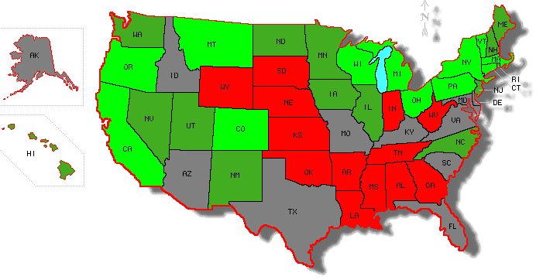
Forest Bioenergy Policy Index 2013
Oregon | 24
Federal | 21
California | 16
Colorado | 15
Connecticut | 15
Vermont | 15
Wisconsin | 15
Arkansas | 3
Louisiana | 3
Oklahoma | 3
Mississippi | 2
S Dakota | 2
Wyoming | 2
Notes:
Previous study identified no regional differences (Guo et al. 2012)
http://diymaps.net/us_12.php

Slide 13
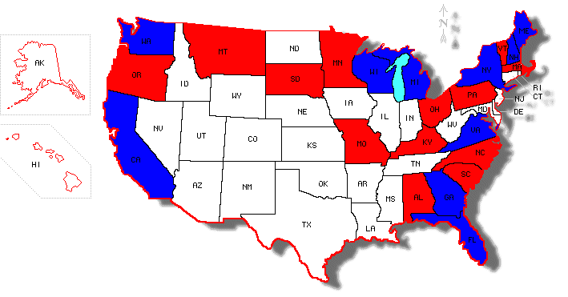
State Leaders in Installed Capacity 2013
Federal | 2840
California | 418
Maine | 348
Florida | 335
Virginia | 272
Michigan | 183
New York | 162
Wisconsin | 143
Georgia | 137
Washington | 126
New Hampshire | 121
Data Source for Capacity: Forisk Consulting LLC
Notes:
Previous study identified no regional differences (Guo et al. 2012)
California and Maine confirm my theory
Colorado and Georgia Connecticut
DOE: confirm with IEA data, see if there is data for 2010-2013
Simultaneous equations? Or maybe lagged capacity in generation equation

Slide 14
Policies and Bioenergy Capacities 2013
Data Source for Capacity: Forisk Consulting LLC
Notes:
Do the policies make people propose plants that might not be online yet (a lag)
Not same thing happening in every state, meaning that it is not only the federal bill

Slide 15
Estimation of Policy Impacts
Capacity_{it}=b1*Policy_{1it}+b2*Controls_{it}+ε_{it}
i= region or a state t=year
Ebers Policy Index: ☺
Policy = arb. weight* policy focus
Notes:
Why to run a regression?
Data is complex so you cant see how variables are related by eye. A lot of noise.
Get standard errors
Comments: -endogeneity of independent variables; remedy: instruments or simultaneous equations or give reasons why exogenous
-try running regression with a different functional form & stochastic specification (regression discontinuity)
A cross-section study: -last year operating capacity & all policies -capacity differences & policies? & year dummy (what drives changes in investment?)

Slide 16
Conclusions
Policy tools classification
State and regional differences
Further work:
Policy interactions? Federal & state local Unintended consequences?
Notes:
http://www.puc.state.pa.us/Electric/pdf/Act129/OBF-ACEEE_OBF_EE_Improvements.pdf
State On-Bill Financing and PAYS programs
On-bill loans and tariff-based financing systems are utility programs designed to help customers pay for energy efficiency upgrades through energy savings programs. These programs are set up so that the utility covers the cost of the energy upgrades and the customers pay the utility back through a charge on their monthly utility bill. Typically the electric and natural gas utilities run these programs, but programs are more successful when state governments adopt legisla­tion or regulations that encourage and enable their adoption.
The participation of the legislature makes a collective effort to require public utility commissions to investigate the feasibility and desirability of such programs, enact laws that provide capital for on-bill programs through public benefit or other funds, establish energy efficiency goals and encourage regulators to adopt rate structures that remove disincentives to investing in energy efficiency and facilitate such investments. Encouragement from the states is important for utility participation in the program because on-bill financing programs are outside the normal business model because they are not simple to design, require an expensive overhaul of old billing systems, and put the utility in the role of a lender.

Slide 17
Thank You!

Slide 18
Dependent Variables
Bioenergy generation variables (Y)
Generating capacity of operating plants (MW)
Other variables of interest:
Number of projects that did not come online
Announced capacity
Number of operating plants
Number of announced plants
Electricity production from woody biomass

Slide 19
Independent Variables
Features and attributes of policies (X1)
-Jurisdiction (state) -Policy approach (incentive, regulation, information) -Policy type, subtype, and specification -Policy strength (levels 1-3) -Year of adoption

Slide 20
Independent Variables II
Other control variables:
-Whole-sale electricity prices -Prices of chips & pellets -Long-term interest rates -Income per capita -State business climate index -Regional dummy -Availability of forest feedstock (no fed lands) -Size of pulp and paper industry dummy (FS)
-Public attitudes towards environment index
Notes:
Vote for Obama?

Slide 21
Other factors influencing forest biomass not included in this study
Public building standards (LEED)
Second generation or advanced biofuel policies
Forest biomass harvesting guidelines
Changes in legal definition of biomass & bioenergy
Utility-led and other private programs
Organized interest groups

Slide 22
Significance of Forest Bioenergy
for electricity: hydro (8%), wind (3%), woody biomass (1%)
useful thermal output of CHP: wood (35%), natural gas (34%), coal (19%)
residential heating source

Slide 23
Source: Georgia Forestry Commission
http://www.gfc.state.ga.us/utilization/forest-biomass/research/ForestBioenergyinGeorgiappt-Jan2010.pdf

Slide 24
Extra graphs
# policies vs states
Score vs states
Score vs number
Bar graphs by policy approach, and strength

