Slide 1
Seed Contracts
&
Climate Change Mitigation Behaviors
Becky Schewe
Feb. 27, 2015

Slide 2
Data Source: U.S. Environmental Protection Agency. April 15, 2014. “Inventory of U.S. Greenhouse Gas Emissions and Sinks.” Table 2-2.

Slide 3
Data Source: U.S. Environmental Protection Agency. April 15, 2014. “Inventory of U.S. Greenhouse Gas Emissions and Sinks.” Table 2-2.

Slide 4
Role of Seed Corn
Jolejole, M.C.B., 2009. Trade-offs, Incentives and the Supply of Ecosystem Services from Cropland. M.S. thesis in Agricultural, Food and Resource Economics. Michigan State University, East Lansing, MI http://www.aec.msu.edu/theses/fulltext/jolejole1 ms.pdf
Millar, N., Robertson, G. P., Grace, P. R., Gehl, R. J., & Hoben, J. P. (2010). Nitrogen fertilizer management for nitrous oxide (N2O) mitigation in intensive corn (Maize) production: an emissions reduction protocol for US Midwest agriculture. Mitigation and Adaptation Strategies for Global Change, 15(2), 185–204. doi:10.1007/s11027-010-9212-7
Preckel, P. V., Shively, G. E., Baker, T. G., Chu, M.-C., & Burrell, J. E. (2000). Contract Incentives and Excessive Nitrogen Use in Agriculture. Journal of Agricultural and Resource Economics, 25(2), 468–484.
Stuart, D. Schewe, R. and McDermott, M.* 2014. “Reducing nitrogen fertilizer application as a climate change mitigation strategy: Understanding farmer decision-making and potential barriers to change in the US.” Land Use Policy, 36(1): 210-218.
Stuart, D., Schewe, R. L., & McDermott, M. (2012). Responding to Climate Change Barriers to Reflexive Modernization in U.S. Agriculture. Organization & Environment, 25(3), 308–327. doi:10.1177/1086026612456536

Slide 5
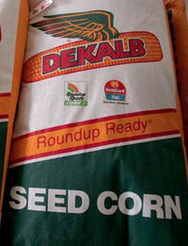
What is Seed Corn?
Contracted with seed company to grow a particular variety or varieties
Annual contracts
Growing next year’s seeds
High profitability, high risk
Global seed competition
Intellectual property rights protection
Tournament ranking

Slide 6
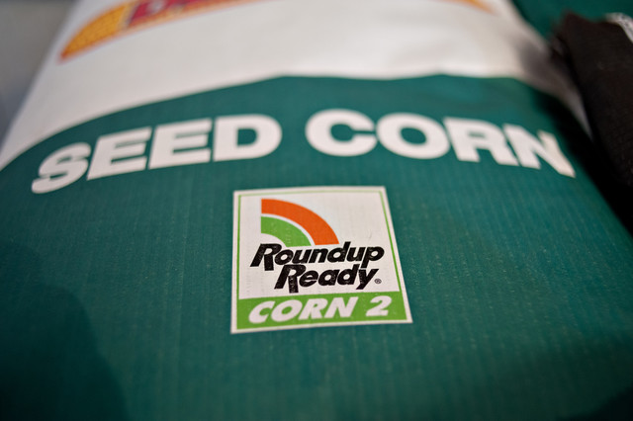
Political Economy of Seed Corn
1. Global Seed Competition
Assigned varieties based on projected demand
Frequent variety changes, unpredictable
Limits knowledge accumulation

Slide 7
Political Economy of Seed Corn
1. Global Seed Competition
“Geez, where I’m at, I’ve got stuff all over the map. I don’t have two fields with the same variety. I get so many different things…. We don’t know the history. You know we used to grow the same variety for maybe 10 years.”
“You really don’t know [how much nitrogen to apply] unless you build some kind of history and get some knowledge behind it.”

Slide 8
Political Economy of Seed Corn
2. Intellectual Property Rights
Provide very limited information to growers
Lack information about expected yield
Lack information about nutrient needs
Limits judicious decisions

Slide 9
Political Economy of Seed Corn
2. Intellectual Property Rights
“Well, some inbreds will only produce 60 bushel and some inbreds will produce 120, 130, 140, 150. So, you have no idea what you’re really putting out there…. We can’t calculate anything.”
“We didn’t even know what we were growing…If you don’t have the yield potential, it’s like you’re shooting in the dark.”

Slide 10
Political Economy of Seed Corn
3. Competitive Contracts
Annual contracts
Tournament contracts
Incentivizes application

Slide 11
Political Economy of Seed Corn
3. Competitive Contracts
“When you are competing against others for seed corn contract yields, you are reluctant to cut {nitrogen} use further.”
“Our contracts give us complete flexibility in how much [nitrogen] to apply, but the competitive structure locks us in.”
“That last little bit {of nitrogen} could give you 17-19 bushels, which makes it worth a fortune.”
Preckel, P. V., Shively, G. E., Baker, T. G., Chu, M.-C., & Burrell, J. E. (2000). Contract Incentives and Excessive Nitrogen Use in Agriculture. Journal of Agricultural and Resource Economics, 25(2), 468–484.

Slide 12
Summary
Contracts create barriers to mitigation behaviors

Slide 13
 | Comm. Corn Growers | Seed Corn Growers
Avg. N Applied (lbs./acre) | 108.19 lbs. | 133.58 lbs.
F | 5.46*
Notes:
25.39 lbs./acre

Slide 14
 | Comm. Corn Growers | Seed Corn Growers
Avg. Farm Size | 271 acres | 517 acres
F | 6.62**
Notes:
Nearly twice as large on average,

Slide 15
Failure to Adopt
 | Would you be interested in enrolling in mitigation incentive payment program?
 | All Farms | Commercial Corn | Seed Corn
Yes | 20% | 19% | 8%
Maybe | 62% | 60% | 72%
No | 18% | 21% | 20%
 |  | p = .02

Slide 16
Failure to Adopt
 | Would participate without the support of the seed company?
Yes | 15%
Maybe | 34%
No | 51%

Slide 18
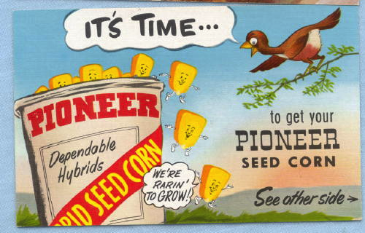

Slide 19
 | Worst Case | Typical Year | Best Case
Seed Corn | Contract not renewed Late planting seed OR No planting Losses >$250,000 | Contract renewed 60,000-90,000 bu of corn >$150,000 | Contract renewed 120,000 bu of corn Top 5% producer >$250,000 + >$70,000 bonus
Commercial Corn | Drought Blight Crop loss Losses >$100,000 | 271 acres, 150-180 bu/acre 40,000-50,000 bu of corn >$80,000 | 271 acres, 200-250 bu/acre 55,000-70,000 bu of corn >$100,000
 | Crop Insurance: $163-312/acre

Slide 20
The Issue: Nitrogen Fertilizer Use
Synthetic N application increased 400% since 1930
(Robertson and Vitousek 2009)
US increase 16% 1990-2007 (USDA 2012)
Continuing over-application
  50% of farms applying more than recommended
  (Millar et al. 2010)

Slide 21
Political Economy of Seed Corn
1. Global Seed Competition
“They’re just advancing them so fast.[Seed company A] wants to get it out ahead of [seed company B]. So everybody’s beating the other guy over the head nonstop to try to get that extra sale unit. To bring it to market quicker.”
“The thing that does cost us is that they’re turning over product and wanting us to grow inbreds that they’re not familiar with. We’re getting less and less testing and less information with regard to what we should do as growers. We’re becoming more and more their production research. ”

Slide 22
Political Economy of Seed Corn
3. Competitive Contracts
“We have a fear of losing our contracts, we need to protect our position.”
“Our contracts give us complete flexibility in how much [nitrogen] to apply, but the competitive structure locks us in.”

Slide 23
Political Economy of Seed Corn
3. Competitive Contracts
“That last little bit {of nitrogen} could give you 17-19 bushels, which makes it worth a fortune.”
“I really miss the days when you could just be happy for your neighbor’s good looking corn field. Because now we don’t know who we’re competing with. You’re wondering if you have to compete against that, the idea is that everything is competitive.”

Slide 24
Possible, Adaptable, Gainful:
Normative and political economic barriers to adopting climate change mitigation practices
Rebecca L. Schewe

Slide 25
Introduction
Rural Sociology
Environmental and Natural Resource Sociology
How do human systems and natural systems interact?

Slide 26
Today’s Story:
Agriculture and Climate Change
Willingness to adopt mitigation behaviors
“Why don’t farmers do what we tell them?”
Norms and values
Structure (political economy) of the system

Slide 27
Roadmap
Background
First Half: Methods and Theory
Second Half: Findings and Implications

Slide 28
The Issue: Nitrogen Fertilizer Use
Synthetic N application increased 400% since 1930
(Robertson and Vitousek 2009)
US increase 16% 1990-2007 (USDA 2012)
Continuing over-application
  50% of farms applying more than recommended
  (Millar et al. 2010)

Slide 29
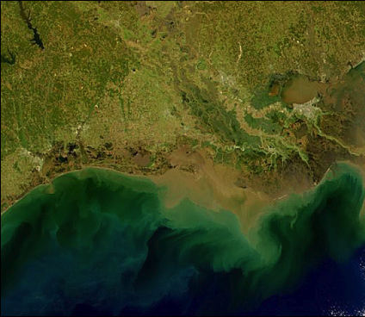
The Issue: Nitrogen Fertilizer Use
Climate Change: N₂O
Agriculture: 70% of US N₂O emissions
N₂O: 298 x of CO₂ heat trapping capacity
N₂O increasing by ~150 Tg/year (Mosier, 2002)
Notes:
N2O is only about 5% of the GHG emissions from human activity, but 298 times the heat trapping capacity

Slide 30
The Issue: Potential Policy
Payment program to reduce N₂O?
Payments for net reduction in N application
  Low end of the “Profitable N Rate Range”
Potential 50% reduction in N₂O release
  (Millar 2010)

Slide 31
The Issue: Potential Policy
Kyoto Protocol and agriculture
  Mitigation requirements:
    Reduce GHG emissions
  Adaptation requirements:
    Prepare for climate change effects

Slide 32
Case Background: N Fertilizer Use
Crucial for yield
Two key criteria:
  Existing N soil content
  Expected yield

Slide 33
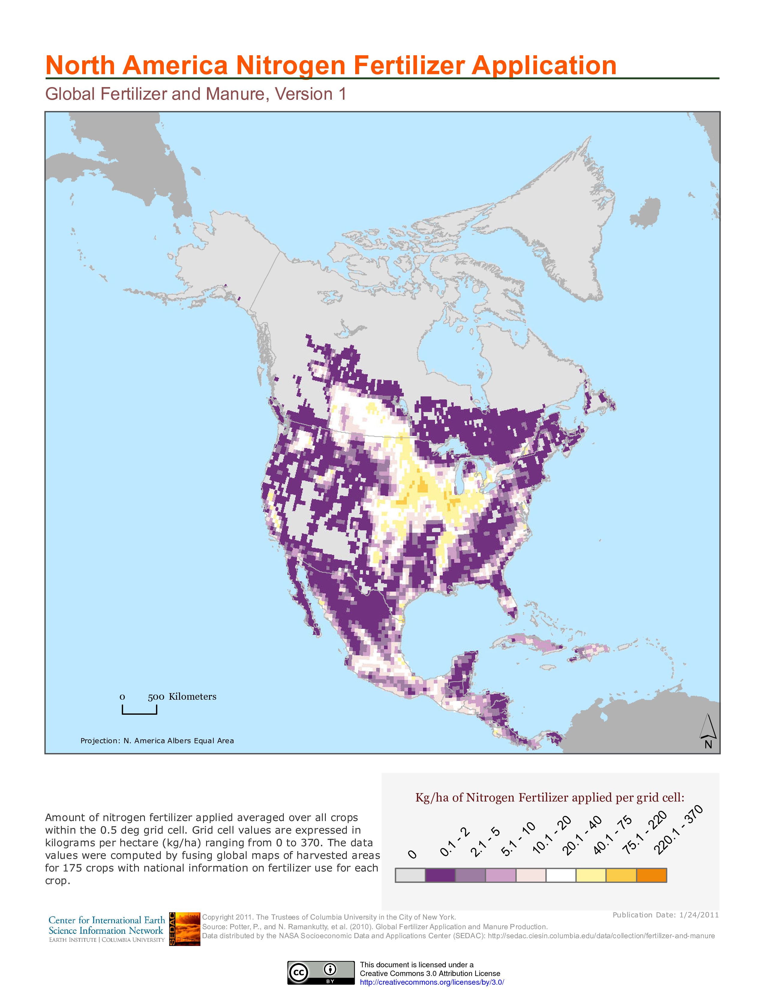

Slide 34
The Questions
Under what circumstances are individuals willing to adopt mitigation behaviors?
Can natural resource policy help create the necessary and sufficient conditions to encourage individuals to adopt mitigation practices that are not in their immediate self-interest?

Slide 35
Key Findings
Significant barriers to adoption:
  Failure to recognize climate change risk
  Productivist social norms
  Political economy of corn production
Existing policy does not address these barriers

Slide 36
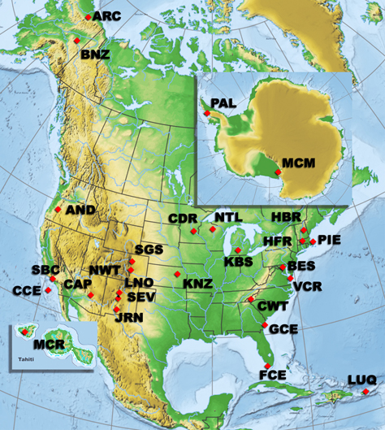

Long-Term Ecological Research Network
NSF 1980
27 sites

Slide 37
Social Science LTER
LTER
  23 years of biophysical data
  Focus on conservation practices and N fertilizer
What are current conservation practices?
What determines these practices?
What are the possibilities for encouraging conservation practices?
Notes:
Global nitrogen fertilizer use has increase approximately 10 fold since 1950, hypoxia and groundwater pollution, 60% of US coastal rivers and bays have been degraded by nutrient pollution and the dead zone in the gulf of has covered an average of 6,000 square miles over the past five years and the National Oceanic and Atmospheric Administration expects it to be over 7,800 square miles this year (University of Michigan, 2009).
Increasing concern about contibution of nitrogen fertilizer to nitrous oxide in the atmosphere, which traps heat at about 300 times the rate of CO2, agriculture contributes about 70% of the US N20 emmissions in the US.

Slide 38
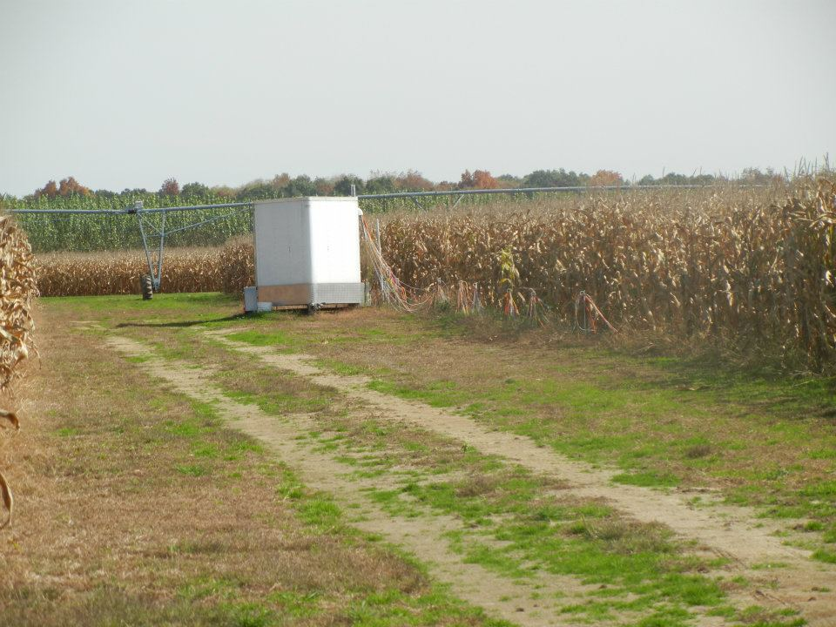
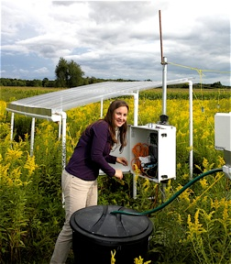
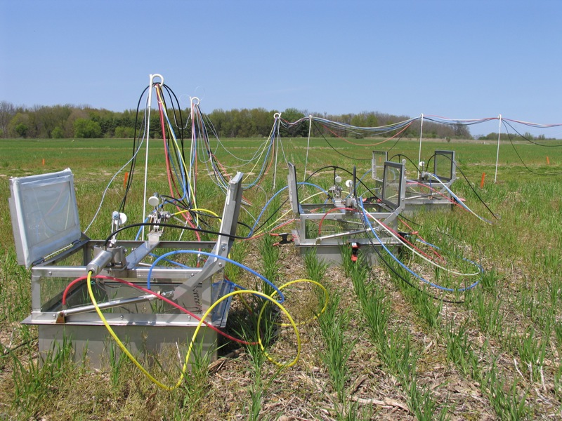

Slide 39
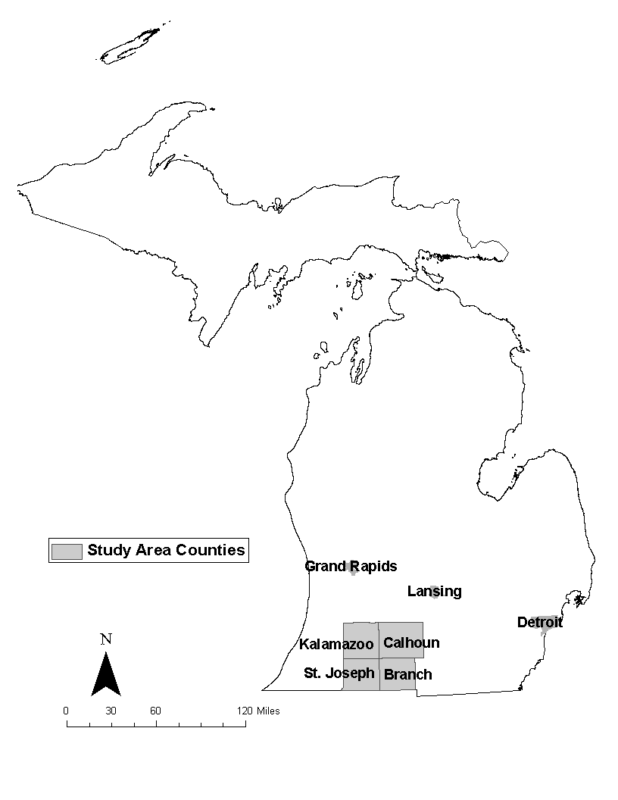
Methods and Data
Study Population:
  Commercial Corn
  Seed Corn

Slide 40
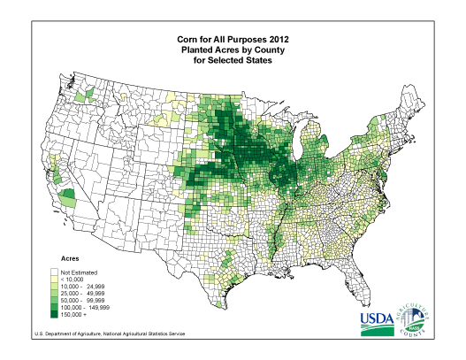
Why Corn?
Corn, Corn, Everywhere

Slide 41
Research Methods
Focus Groups
  4
Personal Interviews
  40
Mail Survey
  1000 growers
  Stratified sample
Notes:
Average farm size: 306 acres in CORN (230 football fields)
Largest 4700, median 150 acres, smallest 10 acres

Slide 42
Our Survey
8 pages, 54 questions
Pre-tests
Focus group
Mailings:
  Cover letter and survey (2/18/11)
  Postcard (2/25/11)
  2nd cover letter and survey (3/4/11)
  3rd cover letter and survey (3/18/11)

Slide 43
Sampling
 |  | POPULATION |  |  |  |  |  | SAMPLE
Stratum |  | Branch | Calhoun | Kalamazoo | St. Joseph | Total |  | Sampled | Sampling
 | acres | farms | farms | farms | farms | Farms (N) |  | farms (n) | rate | pweight
1 | 1--49 | 194 | 176 | 82 | 182 | 634 |  | 340 | 0.54 | 1.86
2 | 50--199 | 124 | 149 | 62 | 103 | 438 |  | 300 | 0.68 | 1.46
3 | 200--499 | 63 | 74 | 36 | 61 | 234 |  | 200 | 0.85 | 1.17
4 | 500+ | 45 | 37 | 34 | 45 | 161 |  | 161 | 1 | 1
 | all | 426 | 436 | 214 | 391 | 1467 |  | 1000

Slide 44
Response and Coding
293 returned, 1 angry letter
  275 in final sample
157 variables from each survey
Inter-rater reliability

Slide 45
Response Rate
Response rate ~29%
Non-response bias?
Compared to census and existing data sets

Slide 46
Our Focus Groups
Recruited at farm meetings
Recruited through Extension
4-10 participants
Script focused on N management
  Second half on climate change specifically

Slide 47
Our Interviews
40 Interviews
11 farmers in Calhoun County
9 in Kalamazoo County
12 in St. Joseph County
8 in Branch County
23 commercial corn growers
11 seed corn growers
11 growers of both

Slide 48
Our Interviews
Recruited at farm meetings
Recruited through Extension
Snowball sampled
Script focused on N management and conservation
  Second half on climate change specifically

Slide 49
Triangulation
Each method gives us something unique
Survey | Interviews | Focus Groups
Large Sample Representative Sample Generalizability | In-depth Processes Reasoning Lived Experience | Points of (Dis)agreement Diversity and Commonalities

Slide 50
Analysis
Survey Analysis
Interview Coding
Focus Group Coding

Slide 51
Man, Mind, and Land: A Theory of Resource Use (Firey, 1960)
Resource practices exist within larger Resource systems
Comprehensive theory of resource use and policy
  Ecological (Possible)
  Social (Adaptable)
  Economic (Gainful)

Slide 52
Three-Dimensional Theory of Resource Use
“It is too much to expect that human agents will freely abandon present resource practices and adopt new ones for the sake of an abstract goal such as {ecological sustainability}. Some more compelling reason must be given a population to induce it to accept a change in its resource practices” (Firey 1960:14)

Slide 53
Possibility
Firey: two parts
Recognition of the ecological impact of resource practice
Recognition that advocated practice approaches ecological optimum

Slide 54
Adaptability
Adaptable:
  Social norms and values
“Any resource process, to be adopted, must first be valued (i.e. accorded some worth) by a people in terms of their system of activities” and social norms (16)
“so pervasive is the role of culture in fixing people’s perception and manipulation of natural phenomena that different populations, though occupying the same habitat, may have literally different resources” (16)

Slide 55
Gainfulness
Gainful:
  Economic profitability/efficiency
“A gainful set of resource processes is one whose elements (processes) all have not less than a formally stated degree of productive efficiency” (20)

Slide 56
Three Dimensional Theory
All three simultaneously to expect change

Slide 57
Refresher
Willingness to adopt mitigation behaviors
Nitrogen fertilizer
  Greenhouse gas
  Over-application

Slide 58
Refresher
Methods:
  Corn farmers
  Survey
  Interview
  Focus groups
Theory
  Walter Firey: three dimensional theory

Slide 59
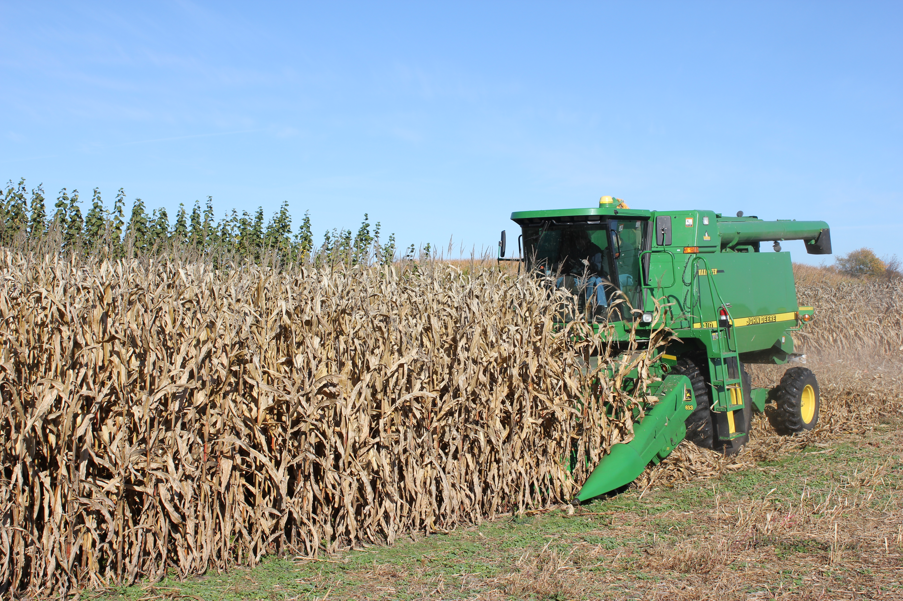
Three-Dimensional Theory of Resource Use
Intensive row-crop agriculture is well-established resource system
  (Im)Possible: Failure to climate recognize risk and connections
  (Un)Adaptable: Productivist social norms
  (Un)Gainful: Political economy of corn production

Slide 60
Farmers and Climate Change
Farmers’ Climate Denial | Arbuckle Jr. et al. 2013 Haden et al. 2012 Stuart, Schewe, and McDermott 2012 White and Selfa 2013
Productivism | Bell 2004 Burton and Wilson 2006 Evan, Morris, and Winter 2002 Jay 2007 Wilson 2001
Gainful | Why? Structural constraints

Slide 61
Findings Overview
Possibility:
  Climate change denial
Adaptability:
  Productivist social norms
Gainfulness:
  Seed corn contract

Slide 62
Possibility
Widespread failure to recognize anthropogenic climate change
Lack of knowledge about linkages between N fertilizer and anthropogenic climate change

Slide 63
Possibility
“Do you think climate change is an issue that society should be concerned about?”
  39% NO
“Do you think that farmers could play an important role in reducing greenhouse gas emissions?”
  32% NO

Slide 64
Possibility
“I think it’s a myth and I think {climate policy and research} is a waste.”
“I work outside everyday and I haven’t noticed my winters getting a lot warmer.”
“I don’t even know if global warming is even true. Who is to say this isn’t a cycle? 600 years ago there was no one around to keep track… I don’t buy any of that bullshit.”

Slide 65
Possibility
64% reported unaware of N fertilizer and N₂O
57% unaware that N₂O is a GHG
“I don’t know whether it is or not.”
“{I had} never heard of it until you showed up.”

Slide 66
Adaptability
Adaptable:
  Social norms and values

Slide 67
Adaptability
Productivist social norms
Success = Yield

Slide 68
Adaptability
24% prioritize maximizing yield over economic profitability

Slide 69
Adaptability
“When you go to the {grain} elevator and sit down at the liars’ table, your yield gets up there.”
“That’s hard, because if you could convince someone to use less fertilizer… that’s saving some money there, but they are giving up yield,” and “some guys just want high yield no matter what it costs them.”

Slide 70
Adaptability
“There’s a lot of farmers that equate: ‘less nitrogen is going to mean my yield is lower,’ and they don’t want to do that because that means they’re not getting {the production} they got last year.”
“When we have a bad year, we all jump right to ‘I didn’t put enough fertilizer on.’”

Slide 71
Adaptability
Focus group coordinator: Is that contest based on the yield then?
Farmer 1: Yeah, there is no economic sense to it at all.
Farmer 2: {In farming} lowest cost producer wins.
Farmer 1: Not the National Corn Growers award, though.
Farmer 2: Well, yeah. That’s right.

Slide 72
Seed Corn Contracts
Contracted with seed company to grow a particular variety or varieties
Growing next year’s seeds
High profitability, high risk
Global seed competition
Intellectual property rights protection
Competitive ranking

Slide 73
 | Worst Case | Typical Year | Best Case
Seed Corn | Contract not renewed Late planting seed OR No planting Losses >$250,000 | Contract renewed 60,000-90,000 bu of corn >$150,000 | Contract renewed 120,000 bu of corn Top 5% producer >$250,000 + >$70,000 bonus
Commercial Corn | Drought Blight Crop loss Losses >$100,000 | 271 acres, 150-180 bu/acre 40,000-50,000 bu of corn >$80,000 | 271 acres, 200-250 bu/acre 55,000-70,000 bu of corn >$100,000
 | Crop Insurance: $163-312/acre

Slide 74
Political Economy of Seed Corn
1. Global Seed Competition
Assigned varieties based on projected demand
Frequent variety changes, unpredictable

Slide 75
Political Economy of Seed Corn
1. Global Seed Competition
“Geez, where I’m at, I’ve got stuff all over the map. I don’t have two fields with the same variety. I get so many different things…. We don’t know the history. You know we used to grow the same variety for maybe 10 years.”
“You really don’t know [how much nitrogen to apply] unless you build some kind of history and get some knowledge behind it.”

Slide 76
Political Economy of Seed Corn
1. Global Seed Competition
“They’re just advancing them so fast.[Seed company A] wants to get it out ahead of [seed company B]. So everybody’s beating the other guy over the head nonstop to try to get that extra sale unit. To bring it to market quicker.”
“The thing that does cost us is that they’re turning over product and wanting us to grow inbreds that they’re not familiar with. We’re getting less and less testing and less information with regard to what we should do as growers. We’re becoming more and more their production research. ”

Slide 77
Political Economy of Seed Corn
2. Intellectual Property Rights
“Well, some inbreds will only produce 60 bushel and some inbreds will produce 120, 130, 140, 150. So, you have no idea what you’re really putting out there…. We can’t calculate anything.”
“We didn’t even know what we were growing…If you don’t have the yield potential, it’s like you’re shooting in the dark.”

Slide 78
Political Economy of Seed Corn
3. Competitive Contracts
“In our company there have been a lot of cutbacks and it’s always those five guys at the bottom who get cut, it’s a big motivation. But you see what it does, is, it really drives this abuse of inputs.”
“We have a fear of losing our contracts, we need to protect our position.”
“Both contracts are based off of yield goals, so therefore, if you don’t have the amount of nutrients out there and you don’t meet your yield goal, you won’t get paid for it. You’re expected to make a goal, and if you don’t, you run the risk of being cut as a grower.”

Slide 79
Political Economy of Seed Corn
3. Competitive Contracts
“When you are competing against others for seed corn contract yields, you are reluctant to cut {nitrogen} use further.”
“Our contracts give us complete flexibility in how much [nitrogen] to apply, but the competitive structure locks us in.”

Slide 80
Political Economy of Seed Corn
3. Competitive Contracts
“That last little bit {of nitrogen} could give you 17-19 bushels, which makes it worth a fortune.”
“I really miss the days when you could just be happy for your neighbor’s good looking corn field. Because now we don’t know who we’re competing with. You’re wondering if you have to compete against that, the idea is that everything is competitive.”

Slide 81
 | Comm. Corn Growers | Seed Corn Growers
Avg. N Applied (lbs./acre) | 108.19 lbs. | 133.58 lbs.
F | 5.46*
Notes:
25.39 lbs./acre

Slide 82
 | Comm. Corn Growers | Seed Corn Growers
Avg. Farm Size | 271 acres | 517 acres
F | 6.62**
Notes:
Nearly twice as large on average,

Slide 83
Failure to Adopt
 | Would you be interested in enrolling in mitigation incentive payment program?
 | All Farms | Commercial Corn | Seed Corn
Yes | 20% | 19% | 8%
Maybe | 62% | 60% | 72%
No | 18% | 21% | 20%
 |  | p = .02

Slide 84
Failure to Adopt
 | Would participate without the support of the seed company?
Yes | 15%
Maybe | 34%
No | 51%

Slide 85
“The most honest answer I can give you is if it had the blessing of my {seed company} production manager, I would do it. If not, I won’t touch it with a 10 foot pole, I don’t care how much it pays.”

Slide 86
So What?
Market-based climate policy
Climate Denial
Interdisciplinary conservation research

Slide 87
Policy Implications
Policy Implications: Neoliberal regulations
Changing roles of state and market
Classically “liberal”:
  Regulations aimed at individual actors and actions

Slide 88
Policy Implications
Tripartite dimensions
Existing policies focused only on either Possibility or Gainfulness
  Don’t recognize rural climate change denial
  Don’t recognize productivist social norms
  Don’t recognize structural constraints

Slide 89
Policy Implications
Possibility:
Without recognition of ecological reality of anthropogenic climate change, policy is doomed to fail

Slide 90
Possibility
  University Extension services
    31% rely on University Extension for information regarding nitrogen fertilizer
    16% reported that the University was their most important source of information, second only to seed companies at 18%
  “This information should be available to us through Extension. It never entered my mind.”

Slide 91
Policy Implications
Adaptability:
  Redefining “the good farmer”
Performance-based environmental management (McGuire et al. 2013)

Slide 92
Policy Implications: Adaptability
Payments themselves should reflect different measures
  Efficiency, not net application
“This type of program rewards the most inefficient. So if I’m just out there throwing N on and I can reduce my rates much greater than X can, who is being very efficient, I’m going to benefit more from this program.”

Slide 93
Policy Implications
Structural reforms
  De-concentration
  Precautionary principle: slower introduction of GE
  Contract reforms
Traditional regulatory approach is unlikely

Slide 94
Political Economy of Farmers’ Climate Change Denial
Theory still relevant
Farmers’ Climate Denial | Arbuckle Jr. et al. 2013 Haden et al. 2012 Stuart, Schewe, and McDermott 2012 White and Selfa 2013
Political Economy | Structural constraints

Slide 95
Conservation Research
Continued need for interdisciplinary research
  Agriculture and climate change
  Human dimensions of the natural environment
Connect conservation research and policy to lived experience and structural resources and constraints

Slide 96
Thank You

Slide 97
Thank You

Slide 98
Future Directions
Predictors of climate change attitudes and conservation practices
  Relationship between attitudes and practices
  Relationships with USDA conservation programs
Latent class analysis

Slide 99
What’s up with climate change values?
CLIMATE CHANGE PERSONAL |  | Model 1 | Model 2 | Model 3 | Model 4 | Model 5
Sociodemographic | Age | -0.0199 | -0.0283 | -0.0247 | 0.0149 | 0.0507
 | Gender | 0.1846*** | 0.1759*** | 0.1569* | 0.1268 | 0.1118
 | Education | -0.072 | -0.0598 | -0.068 | -0.111 | -0.0852
 | HH income | -0.0628 | -0.0814 | -0.0762 | -0.1088 | -0.0741
 | Zipcode | 0.0967* | 0.1099* | 0.1105* | 0.0774* | 0.0817*
Farm Business | Farm main income |  | 0.0526 | 0.0328 | 0.0049 | 0.006
 | Form business org. |  | 0.0428 | 0.0443 | 0.071 | 0.1014
 | Own/Rent Ratio |  | -0.0675 | -0.0799 | -0.036 | -0.0517
 | Acres in Corn/Soy |  | -0.0079 | -0.0068 | 0.027 | 0.0196
Agronomic | Soil Type |  |  | 0.056 | 0.0244 | 0.0724
 | Irrigated/non-irr ratio |  |  | -0.0069 | 0.0228 | -0.001
Cons. Programs | EQIP |  |  |  | -0.1145 | -0.1192
 | CRP |  |  |  | 0.0361 | -0.0158
 | CSP |  |  |  | 0.1127 | 0.0824
 | MAEAP |  |  |  | 0.0714 | 0.1229
Cons. Practices | CC planter |  |  |  |  | -0.0888
 | No till user |  |  |  |  | 0.1318
 | Cont. corn planter |  |  |  |  | 0.0699
 | Df | 1259 | 1242 | 1226 | 1026 | 953
 | F | 3.60 | 3.17 | 2.55 | 1.83 | 1.75
 | Prob > F | 0.0031 | 0.0009 | 0.0035 | 0.0263 | 0.0266
 | Adjusted Wald Test (F) | 3.60 | 0.78 | 0.39 | 1.39 | 2.01
 | Prob > F | 0.0031 | 0.5392 | 0.6787 | 0.2366 | 0.1107

Slide 100
What’s up with climate change values?
CLIMATE CHANGE PERSONAL |  | Model 1 | Model 2 | Model 3 | Model 4 | Model 5
Sociodemographic | Age | -0.0452 | -0.0313 | 0.0091 | 0.0141 | 0.0349
 | Gender | 0.1547* | 0.1543* | 0.124 | 0.0839 | 0.0592
 | Education | -0.0582 | -0.0526 | -0.0249 | -0.0772 | -0.0855
 | HH income | 0.066 | 0.0638 | 0.0646 | 0.0001 | 0.0181
 | Zipcode | 0.0916 | 0.0976 | 0.1048* | 0.0333 | 0.0442
Farm Business | Farm main income |  | 0.0159 | 0.0366 | -0.0214 | -0.0394
 | Form business org. |  | 0.0416 | 0.0535 | 0.0681 | 0.0897
 | Own/Rent Ratio |  | -0.0491 | -0.0523 | -0.0279 | -0.0046
 | Acres in Corn/Soy |  | 0.0225 | 0.0137 | 0.0058 | -0.0229
Agronomic | Soil Type |  |  | 0.0187 | 0.0099 | 0.0283
 | Irrigated/non-irr ratio |  |  | 0.0395 | 0.0659 | 0.0547
Conservation Programs | EQIP |  |  |  | -0.0079 | -0.0026
 | CRP |  |  |  | 0.0825 | 0.0428
 | CSP |  |  |  | 0.1589 | 0.1131
 | MAEAP |  |  |  | 0.1903*** | 0.165*
Conservation Practices | CC planter |  |  |  |  | -0.0897
 | No till user |  |  |  |  | 0.2077*
 | Cont. corn planter |  |  |  |  | 0.0049
 | Df | 1251 | 1235 | 1218 | 1019 | 948
 | F | 1.88 | 1.82 | 1.49 | 2.02 | 1.67
 | Prob > F | 0.0955 | 0.0602 | 0.1284 | 0.0117 | 0.0387
 | Adjusted Wald Test (F) | 1.88 | 0.53 | 0.29 | 4.51 | 1.95
 | Prob > F | 0.0955 | 0.7163 | 0.7496 | 0.0013 | 0.1201

Slide 101
What’s up with cover crops?
COVER CROP PLANTER |  | Model 1 | Model 2 | Model 3 | Model 4 | Model 5
Sociodemographic | Age | -0.1092 | -0.087 | -0.0893 | -0.0066 | -0.0997
 | Gender | -0.1192 | -0.1139 | -0.1175 | -0.5341 | -0.0812
 | Education | -0.0536 | -0.0289 | -0.0592 | -0.0407 | -0.0878
 | HH income | 0.0943 | 0.0726 | 0.0752 | 0.0686 | 0.0998
 | Zipcode | -0.0462 | -0.0183 | -0.0185 | 0 | -0.0409
Farm Business | Farm main income |  | 0.2466*** | 0.255*** | 0.3975* | 0.2251***
 | Form business org. |  | -0.0369 | -0.0433 | -0.0013 | -0.0573
 | Own/Rent Ratio |  | -0.0459 | -0.0639 | 0.0091 | -0.0069
 | Acres in Corn/Soy |  | 0.0102 | -0.0207 | -0.0001 | -0.053
Agronomic | Soil Type |  |  | 0.1218 | 0.0652 | 0.0861
 | Irr/non-irr ratio |  |  | 0.0992*** | 0.754* | 0.0948*
Cons. Prog. | EQIP |  |  |  | 0.1616 | 0.0533
 | CRP |  |  |  | 0.1798 | 0.0262
 | CSP |  |  |  | 0.1449 | 0.052
 | MAEAP |  |  |  | 0.4068 | 0.1206
CC Values | GW personal important |  |  |  |  | -0.0636
 | GW social important |  |  |  |  | -0.0552
 | Df | 1281 | 1260 | 1243 | 1036 | 1002
 | F | 1.90 | 4.12 | 5.11 | 3.32 | 3.14
 | Prob > F | 0.092 | 0.0000 | 0.0000 | 0.0000 | 0.0000
 | Adjusted Wald Test (F) | 1.90 | 4.34 | 4.90 | 1.90 | 0.65
 | Prob > F | 0.092 | 0.0017 | 0.0076 | 0.1081 | 0.5199

Slide 102
Theoretical Implications
Extend Firey’s three-dimensional theory to agriculture and climate change
Established resource systems resist change

Slide 103
Long-Term Ecological Research Network
NSF 1980
27 sites

Slide 104
Social Science LTER
Human dimensions of ecological change
KBS: agricultural LTER site
Notes:
Global nitrogen fertilizer use has increase approximately 10 fold since 1950, hypoxia and groundwater pollution, 60% of US coastal rivers and bays have been degraded by nutrient pollution and the dead zone in the gulf of has covered an average of 6,000 square miles over the past five years and the National Oceanic and Atmospheric Administration expects it to be over 7,800 square miles this year (University of Michigan, 2009).
Increasing concern about contibution of nitrogen fertilizer to nitrous oxide in the atmosphere, which traps heat at about 300 times the rate of CO2, agriculture contributes about 70% of the US N20 emmissions in the US.

Slide 105
Survey Sampling
 |  | POPULATION |  |  |  |  |  | SAMPLE
Stratum |  | Branch | Calhoun | Kalamazoo | St. Joseph | Total |  | Sampled | Sampling
 | acres | farms | farms | farms | farms | Farms (N) |  | farms (n) | rate | pweight
1 | 1--49 | 194 | 176 | 82 | 182 | 634 |  | 340 | 0.54 | 1.86
2 | 50--199 | 124 | 149 | 62 | 103 | 438 |  | 300 | 0.68 | 1.46
3 | 200--499 | 63 | 74 | 36 | 61 | 234 |  | 200 | 0.85 | 1.17
4 | 500+ | 45 | 37 | 34 | 45 | 161 |  | 161 | 1 | 1
 | all | 426 | 436 | 214 | 391 | 1467 |  | 1000

Slide 106
Response and Coding
293 returned, 1 angry letter
  29% response rate
157 variables from each survey
Inter-rater reliability

Slide 107
Corn, Corn, Everywhere

Slide 108
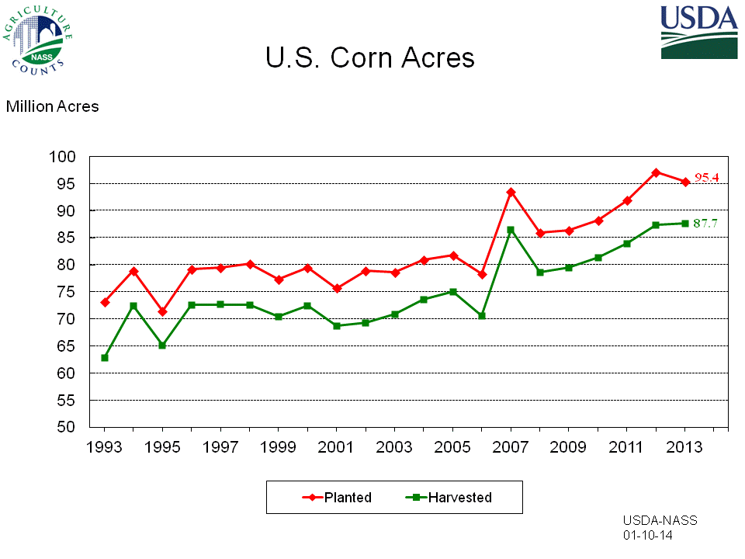
Corn, Corn, Everywhere

Slide 109
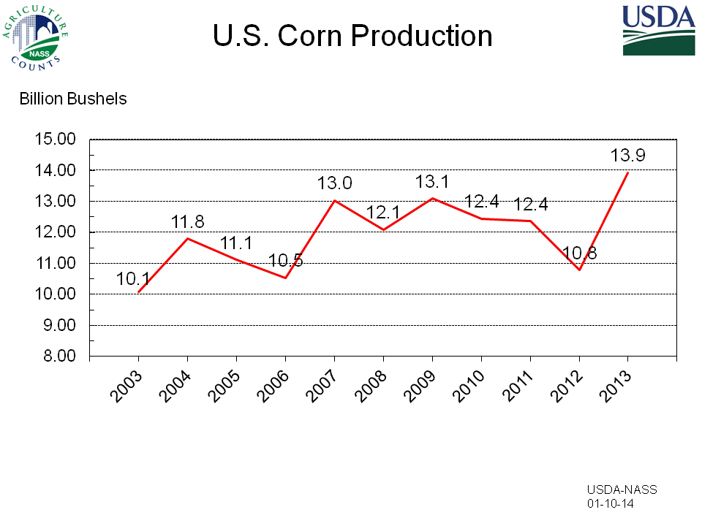

Slide 110
Concentration
1987: DuCon, joint DuPont Conagra venture
1999: DuPont purchases controlling share of Pioneer
2006: DuPont Pioneer and Syngenta joint venture (GreenLeaf Genetics)
2004: IMC and Cargill form Mosaic (fertilizer wing)
Cargill: 25% of US grain market and 22% of US meat market

Slide 111
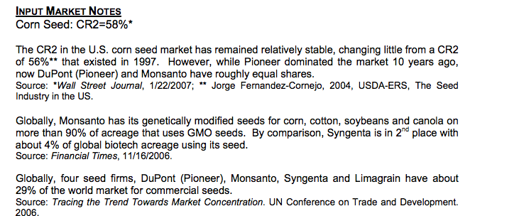
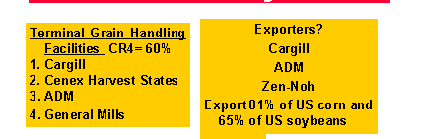
Concentration
Notes:
Bill Heffernan

Slide 112
Concentration
Notes:
Phil Howard

Slide 113
The Issue: Potential Policy
Net reduction in lbs. applied
Undecided:
  Benchmark year
  Payment rate
Potential 50% reduction in N₂O release
  (Millar 2010)

Slide 114
Findings
Possibility
Adaptability
Gainfulness
Policy Implications
Discussion and conclusions

Slide 115
Failure to Adopt
Very limited adoption of existing conservation practices
  95% sometimes use N to break down stalks
  <1% using no-till
  61% never used delayed release N
  60% never test manure for N content
  69% never use PSNT

Slide 116
Failure to Adopt
 | Would you be interested in enrolling?
 | All Farms | Commercial Corn | Seed Corn
Yes | 20% | 19%* | 8%*
Maybe | 62% | 60% | 72%
No | 18% | 21% | 20%
 |  | p = .02

Slide 117
Gainful
Gainful:
  Economic profitability/efficiency
“A gainful set of resource processes is one whose elements (processes) all have not less than a formally stated degree of productive efficiency” (20)

Slide 118
Gainful: Beyond Seed Corn
“It’s going to be a tough thing {to get people to reduce nitrogen}, because if you reduce yields it’s all tied back to crop insurance, and that’s your revenue protection. So for us to take down our yield history, that’s a long-term effect. There would have to be some sort of payments that are pretty drastic {to make nitrogen reductions cost effective}.”

Slide 119
Gainful: Beyond Seed Corn
“Your {yield} is tied to everything, to the bank loans…”

Slide 120
Policy Implications
Tripartite dimensions
Existing policies focused only on either Possibility or Gainfulness
  Don’t recognize rural climate change denial
  Don’t recognize productivist social norms
  Don’t recognize structural constraints

Slide 121
Policy Implications
Possibility:
Without recognition of ecological reality of anthropogenic climate change, policy is doomed to fail

Slide 122
Possibility
  University Extension services
    31% rely on University Extension for information regarding nitrogen fertilizer
    16% reported that the University was their most important source of information, second only to seed companies at 18%
  “This information should be available to us through Extension. It never entered my mind.”

Slide 123
Policy Implications
Adaptability:
  Redefining “the good farmer”
Performance-based environmental management (McGuire et al. 2013)

Slide 124
Policy Implications: Adaptability
Payments themselves should reflect different measures
  Efficiency, not net application
“This type of program rewards the most inefficient. So if I’m just out there throwing N on and I can reduce my rates much greater than X can, who is being very efficient, I’m going to benefit more from this program.”

Slide 125
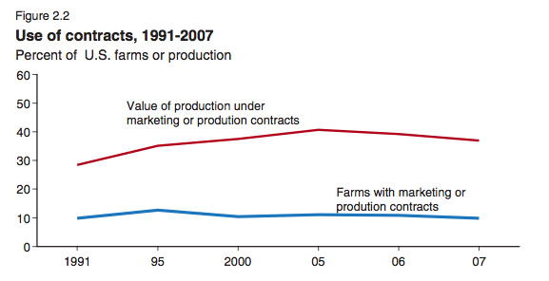

Slide 126
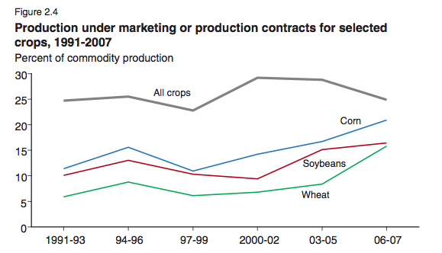

Slide 127
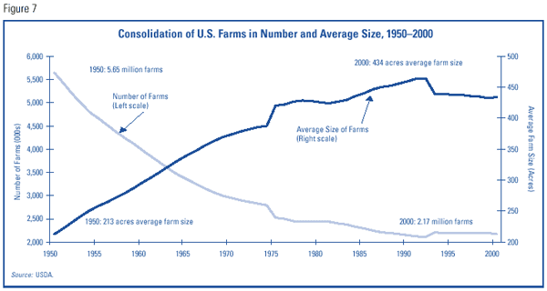

Slide 128
What is a “Corn Farm?”
Average:
  US: 441 acres
  Our sample: 306 acres (230 football fields)
~98% owned by families or family corporations

Slide 129
Antitrust Seed
March 2013, Monsanto and Dupont waved claims against each other
$1B ruling in favor of Monsanto for infringement of soybean tech
Dupont agreed to drop its own antitrust claim against Monsanto
Previous 2010 DOJ investigation of Monsanto, dropped
Licensing agreements with each other
Monsanto’s purchasing of seed companies is secondary strategy, originally they focused on licensing
Notes:
Current Monsanto tech is in 90% of soybeans and 80% of corn in US
2007 Texas, Iowa, and other states started the antitrust inquiries into Monsanto
Mid 1990s 300 seed companies to less than 100

Slide 130
Neoliberal regulation
Shift regulatory responsibility from state to market
Neoliberal logic:
  Environmental “goods” are best provided by market mechanisms
Broader implications

Slide 131
